Slide 1
Day 2

Slide 2
Some basic assertions on the API
API is sending a valid SOAP response ?
Is response sending the Expected status code ?
Are you receiving response within time limit ?
Is there any private variable being exposed ?
Xpath (after xpath class)

Slide 3
Data driven testing
Test suite level
Test case level
Name : Sahil DHiman

Slide 4
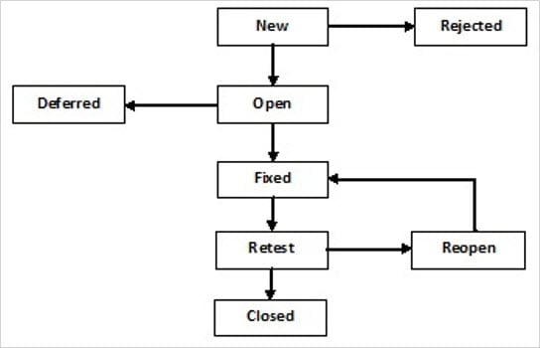
Defect lifecycle

Slide 5
Assignment:
Import the following project in SOAP UI tool, write some test cases(atleast 3), and identify some bugs.
Try some assertions.
Wsdl file: https://graphical.weather.gov/xml/SOAP_server/ndfdXMLserver.php?wsdl
Documentation:
https://graphical.weather.gov/xml/SOAP_server/ndfdXMLserver.php#
https://graphical.weather.gov/xml/SOAP_server/ndfdXML.htm

Slide 6
Introduction to REST

